Slide 1


SDP
LECTURE
The Adapter Pattern
Software Design Patterns
Diploma in IT
Year 2 (2024/25), Semester 4
9.1
Notes:
Hi everyone! This week, we are going to look at a couple of structural design patterns that allow us to transform one interface to another. The first one is called the Adapter pattern, and it does pretty much what you’d expect.

Slide 2
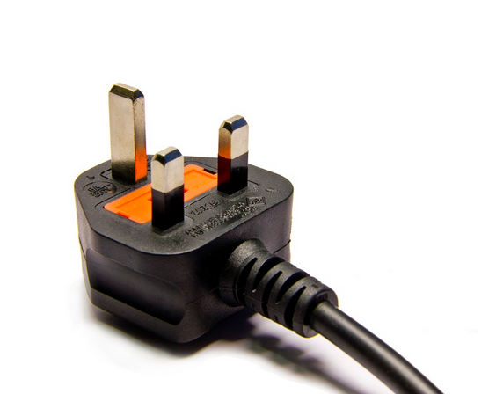
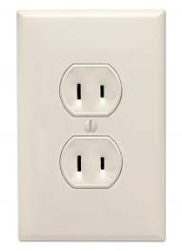
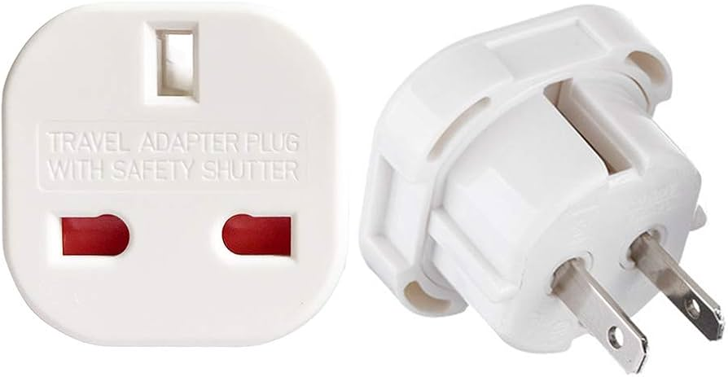
What are Adapters?
Notes:
I’m sure you know about power adapters in real life. For example, suppose you go on a 1-week family holiday in the US, and you find that || your gaming laptop’s 3-pin plug does not match their two-pin wall sockets. Oh no! How will you possibly survive not playing Valorant for a week? No worries, you just get yourself || a power adapter. As you can see, you can || connect your 3-pin plug to the back of the adapter, and then || insert the front of the adapter into the wall socket, and voila, you can now charge your gaming laptop to play your online games and ignore your family, and all is right with the world.

Slide 3
Object Oriented Adapters
Your Existing System
Vendor
Class
Interface doesn’t match!
No code changes
New code
No code changes
Adapter
…and talks to the vendor interface to service your requests
Adapter implements the interface your classes expect
Notes:
The Adapter design pattern does the same thing as a power adapter. Suppose have an existing system, and a vendor creates a class that you want to use with your existing system. The problem is that || the interface of the vendor class does not match what your system expects. To solve this using the Adapter design pattern, we create || an Adapter class. This class will || implement the interface that your existing system expects, and when requests are made by your system using this interface, it will || translate those requests into the vendor interface so that the vendor class can service the request. If all goes well, the Adapter will || serve as a seamless bridge between your system and the vendor class. The cool thing about the Adapter design pattern is that || the existing system and the vendor class are all untouched, and in fact, neither of them will be aware that anything out of the ordinary is happening. Instead, all of the || translating work is done by the new Adapter class. Cool, right?

Slide 4
Duck Simulation, Revisited
Recall our Duck Simulation
For simplicity, we assume a simplified implementation (not using Strategy)
Suppose we want to add Chickens to our Duck Simulation
We want to treat Chickens like Ducks
Notes:
To illustrate how the Adapter pattern works, let’s go back to our Duck Simulation that we introduced way back in Lesson 3, when we introduced Strategy design pattern. Remember that video game with all the ducks? We are going to use a || simplified version of that system that does not use the Strategy design pattern, just to make it easier to understand.
It turns out that we also have an existing Chicken Simulation game, and now we want a full-fledged cross-over event. Essentially, we want to || add chickens into our Duck Simulation in such a way that we can now treat chickens the same way as ducks. Because, chickens, like ducks, are awesome. So, how can we do that?

Slide 5
Current Duck Implementation
public interface Duck {
public void quack();
public void fly();
}
public class MallardDuck : Duck {
public void quack() {
Console.WriteLine(“Quack”);
}
public void fly() {
Console.WriteLine(“I’m flying!”);
}
}
Notes:
Let’s start with the simplified Duck Simulation code. Here we see our Duck interface that specifies two methods quack() and fly(). We have various concrete Duck classes such as a MallardDuck that will override the quack() and fly() methods. Since the MallardDuck is a pretty standard, unassuming duck, its quack() method prints “Quack”, and its fly() method prints “I’m flying!”. There will of course be other ducks, but they all have their own version quack() and fly().

Slide 6
Current Chicken Implementation
public interface Chicken {
public void cluck();
public void fly();
}
public class KampungChicken : Chicken {
public void cluck() {
Console.WriteLine(“Cluck cluck”);
}
public void fly() {
Console.WriteLine(“Flying a short distance”);
}
}
Notes:
Now, let’s look at our Chicken class. We see that the Chicken is also an interface, it also has a fly() method, but instead of a quack() method, it has a || cluck() method. Naturally, there are various subclasses of Chicken, such as a KampungChicken. The KampungChicken overrides the cluck() method to say “Cluck cluck”. As for the fly() method, well, chickens don’t fly as far as ducks, so they || only fly a short distance.

Slide 7
Chicken Adapter
public class ChickenAdapter : Duck {
Chicken chicken;
public ChickenAdapter(Chicken chicken) {
this.chicken = chicken; }
public void quack() {
chicken.cluck();
}
public void fly() {
for (int i = 0; i < 5; i++)
chicken.fly();
}
}
Notes:
OK, so how do we use a Chicken like a Duck? We do so using a ChickenAdapter. The first thing to note is that the ChickenAdapter || implements the Duck interface, so any object of type ChickenAdapter can be treated as a Duck. Next, we need a || reference to the Chicken object that this adapter is adapting, and this is initialized in the constructor. Finally, we need code to specify the Chicken versions of the quack() and fly() methods. The quack() method is pretty simple: we just have the || chicken cluck instead. As for fly(), we might say that a chicken needs to fly 5 times in order to fly as far as one method call of fly() for a duck, so we || call the chicken’s version of fly() 5 times. And that’s all there really is to it.

Slide 8
Let’s Test It
void testDuck(Duck duck) {
duck.quack();
duck.fly();
}
MallardDuck duck = new MallardDuck();
KampungChicken chicken = new KampungChicken();
Duck chickenAdapter = new ChickenAdapter(chicken);
Console.WriteLine(“The duck says:”);
testDuck(duck);
Console.WriteLine(“\nThe chicken says:”);
testDuck(chickenAdapter);
Notes:
Let’s test this out. We write a simple method called || testDuck that takes a Duck object as its argument, and all it does is make the duck quack and fly. Next, we create a new MallardDuck and a new KampungChicken, but for the KampungChicken, we create a || chickenAdapter for it. Note that since the ChickenAdapter implements the Duck interface, it is || actually of type Duck. Finally, we call testDuck on both our || MallardDuck object and our ChickenAdapter object.

Slide 9
Let’s Test It
Output
The duck says:
Quack
I’m flying!
The chicken says:
Cluck cluck
Flying a short distance
Flying a short distance
Flying a short distance
Flying a short distance
Flying a short distance
Notes:
The output should look like this. When we test the MallardDuck, the testDuck() method will call its quack() and fly() methods, which will of course print out “Quack” and “I’m flying!”, respectively. As for the ChickenAdapter object, the testDuck() method has no idea that its argument is anything other than an ordinary Duck. It will first call the quack() method, which the Adapter will translate into chicken.cluck(), and || “Cluck cluck” will be printed. Similarly, when the fly() method is called, the Adapter will translate this into || 5 calls of chicken.fly(). Yes, we have successfully disguised a chicken as a duck. Isn’t technology wonderful?

Slide 10
The Adapter Pattern
Adaptee
(Chicken)
Client
(testDuck)
Adapter
(ChickenAdapter)
request()
translatedRequest()
Notes:
Now that we have seen the Adapter pattern in action, let’s go back to our power socket example to see how everything maps out. In the example, we have a 3-pin plug that is trying to get power from the 2-pin wall socket, so the 3-pin plug is our || Client. In the duck simulation, that’s the class that has the testDuck() method. The power socket is the || Adaptee, which is the thing we are trying to use. In the duck simulation, that’s the Chicken that testDuck() is trying to treat as a Duck. And of course, the || ChickenAdapter class is our Adapter. Essentially, the Client will submit a || request() to the Adapter using its interface, such as quack(), and the adapter will || translate this request into the Adaptee’s interface, such as cluck(). Notice that the Client and Adaptee are not changed at all, we just need to add the Adapter.

Slide 11
The Adapter Pattern
Notes:
Got it? Great. I will now formally introduce the Adapter design pattern.

Slide 12
Definition
The Adapter Pattern:
Converts the interface of a class into another interface the client expects
Lets classes work together that could not otherwise because of incompatible interfaces
Also known as
Wrapper
Notes:
The Adapter pattern converts the interface of one class that does not match what the client wants into another interface that the client does want. Therefore, classes with incompatible interfaces can now work together This pattern is also known as || the Wrapper pattern.

Slide 13
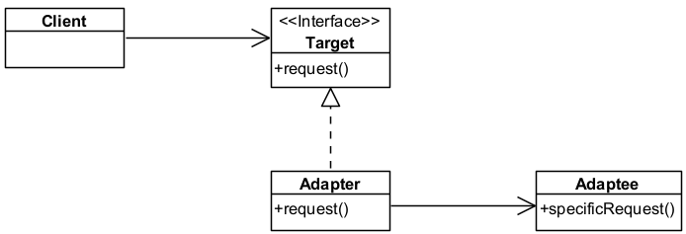
The Adapter Pattern
Notes:
This is the class diagram for the Adapter pattern. We have the || Client class, which is just the class that is trying to use an object that implements some method called request(), and this method is specified by the || Target interface. However, the actual object called the || Adaptee does not have the request() method, instead it has the specificRequest() method. Therefore, we insert and || Adapter class. This class has a || reference to the Adaptee object, and it also || implements the Target interface. The Adapter’s job is to translate request() into some combination of specificRequest() function calls.

Slide 14
Key Participants
Target
Defines the interface that the Client uses.
Client
Uses objects conforming to the Target interface.
Adaptee
Defines an existing interface that needs adapting.
Adapter
Adapts the interface of the Adaptee to the Target interface.
Notes:
In summary, the Adapter pattern has 4 key participants. The || Target defines an interface for objects that the Client uses, while the || Client is the class that uses the objects conforming to this Target interface. Meanwhile, the || Adaptee is the class that defines some existing interface that needs to be adapted to the Target interface. Finally, the || Adapter adapts the interface of the Adaptee to the Target interface.

Slide 15
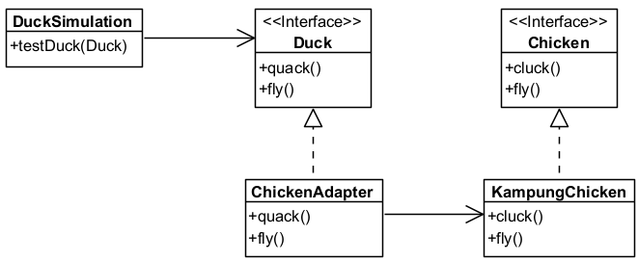
Applying Adapter to Duck Simulation
Client
Target
Adaptee
Adapter
Notes:
In our Duck Simulation, || this is the Client class. OK, this is not quite accurate since we don’t actually have a DuckSimulation class, it’s really just the program that calls testDuck(). Now, testDuck() expects a Duck as an argument, and || Duck is the Target interface, so anything that implements this interface, meaning that it has a quack() and a fly() method, can be used in testDuck(). What we want to use is the KampungChicken object, which is || our Adaptee, but KampungChicken does not have a quack() method, it has a cluck() method. Therefore, we introduce our || Adapter called ChickenAdapter that has a reference to our KampungChicken object and implements the Duck interface. With a little coding, our ChickenAdapter implements the KampungChicken versions of quack() and fly() so that testDuck() can use it just like a Duck.

Slide 16
What Have We Achieved?
We can now use an existing class even though the interface does not match what you need
Helps to make new versions backwards-compatible
We can create a reusable class that cooperates with unrelated or unforeseen classes
E.g., a class that extracts text from different file formats
Notes:
And that’s the Adapter design pattern. What have we achieved? So the obvious benefit is that we can now use an existing class without changing it even though its interface does not match what you need. The adapter pattern is heavily used when we want to make || different versions of systems backwards-compatible, for example so that new versions of Word can open documents created by old versions. The adapter pattern also allows us to create a || reusable class that can cooperate with unrelated or even unforeseen future classes. Imagine a TextExtractor class that takes a file object as an argument and returns the plain text version of that file. Perhaps it can currently handle txt, Word and pdf files, but it can later be extended to handle all kinds of other file formats. You just have to write an adapter for each file type. Neat, right?

Slide 17
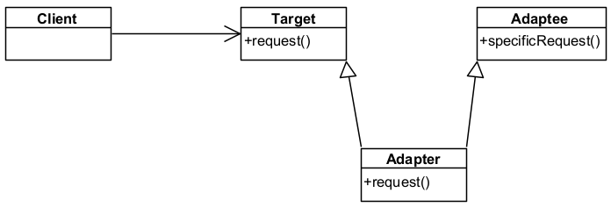
Object Adapter vs. Class Adapter
Object Adapter
Class Adapter (uses multiple inheritance)
Notes:
The Gang of Four book actually defines two ways to implement the Adapter design pattern. The one I’ve shown you is called an Object Adapter, and that one uses composition, as in the Adapter has a reference to the Adaptee. The other version is called a || Class Adapter, and in this version, the Adapter inherits from the Adaptee, so it is a type of Adaptee. The concept is still the same – the Adapter will implement the Adaptee version of the request() method. We are not going to focus on this version because it requires multiple inheritance, where one class inherits from multiple classes, and not all programming languages allow that. While C++ does allow multiple inheritance, C# only allows multiple inheritance with interfaces, and Java doesn’t allow it at all.

Slide 18
Object Adapter vs. Class Adapter
Object Adapter
Lets a single Adapter work with many Adaptees
Can work with Adaptee subclasses
Can add functionality to all Adaptees at once
Makes it harder to override Adaptee subclass behaviour
Class Adapter
Lets Adapter override some of Adaptee’s behaviour
Unable to adapt a class and all of its subclasses
Notes:
Still, if you are going to code using a language that does allow for multiple inheritance, it is good to understand the trade-offs between object and class adapters. The argument is mainly about flexibility vs. efficiency. A single || object adapter works with an Adaptee class and all its subclasses – our ChickenAdapter works with all types of chickens, assuming that its implementation of quack() and fly() applies to all chickens. This also means that || if we want to add a new functionality, say, swim(), we can do that in our object adapter and it will apply to all Adaptee subclasses as well. So object adapters are pretty flexible in this sense. On the other hand, if there are some || Adaptee subclass special cases that do not work in the general way, then in order to override this behaviour, the object adapter will need to compose with the subclass instead of the Adaptee base class, which may get a bit messy.
As for the class adapter, think of it as a specific Adaptee subclass that we are trying to adapt. If your system will only ever want to adapt this subclass, then the class adapter maximizes efficiency. It can override the Adaptee’s behaviour as necessary, and does not require you to maintain a reference to the specific Adaptee object. However, the class adapter cannot affect other subclasses of the Adaptee.

Slide 19
Summary
The Adapter design pattern
Next: The Façade design pattern
Like, share and subscribe!
Notes:
And that was the Adapter design pattern, which converts the interface of one class to another. Pretty easy, right? In the next lesson, we will discuss another structural design pattern called the Façade, which tries to make complicated subsystem interfaces easier to use.
Oh, and my || power adapter is telling all of you to like, share and subscribe to my YouTube channel, and it is not at all embarrassed about saying so. That’s because it’s a shameless plug. Byee!

